Slide 1

Hotel Booking System
Project
Faculty of Information & Computers
AI Department

Slide 2





Team
Ziad
Elgohary
Omar
Bahnasy
Ebrahim
Elsaeed
Hesham
Abdallah
Abdelrahman
Tarek
Supervision
Dr. Osama Ghoneim Eng. Omar Khaled

Slide 3
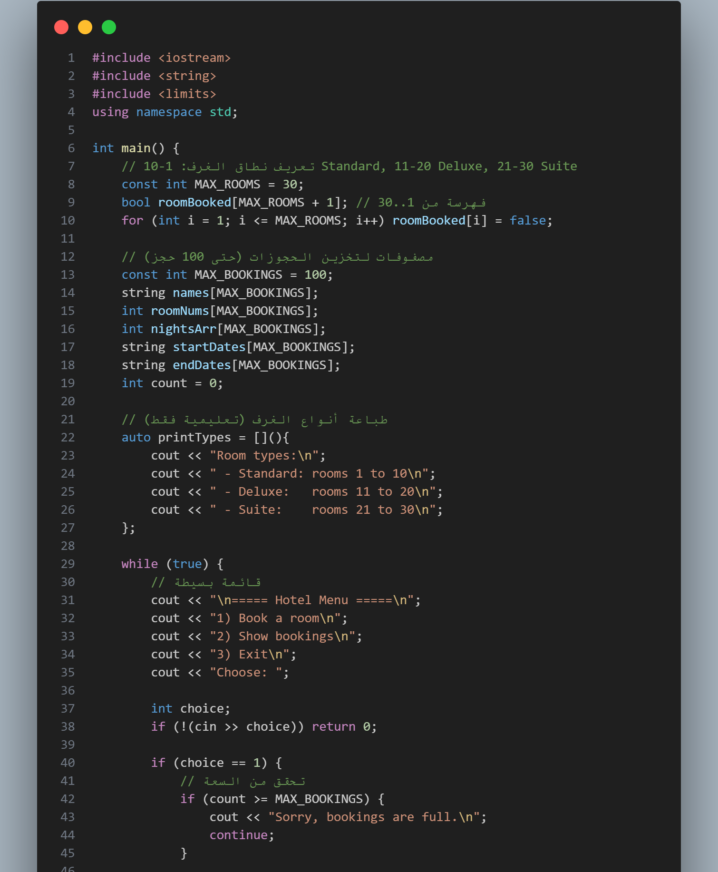
Introduction
Hotel Management System
Objective: A digital solution designed to streamline hotel bookings and prevent manual errors.
Smart Logic: Categorizes rooms (Standard, Deluxe, Suite) and ensures real-time availability tracking.
User Experience: Focused on a clean, fast, and error-proof interface for efficient guest handling.
Key Skills: Demonstrates logical planning, problem-solving, and attention to detail in a business context.

Slide 4
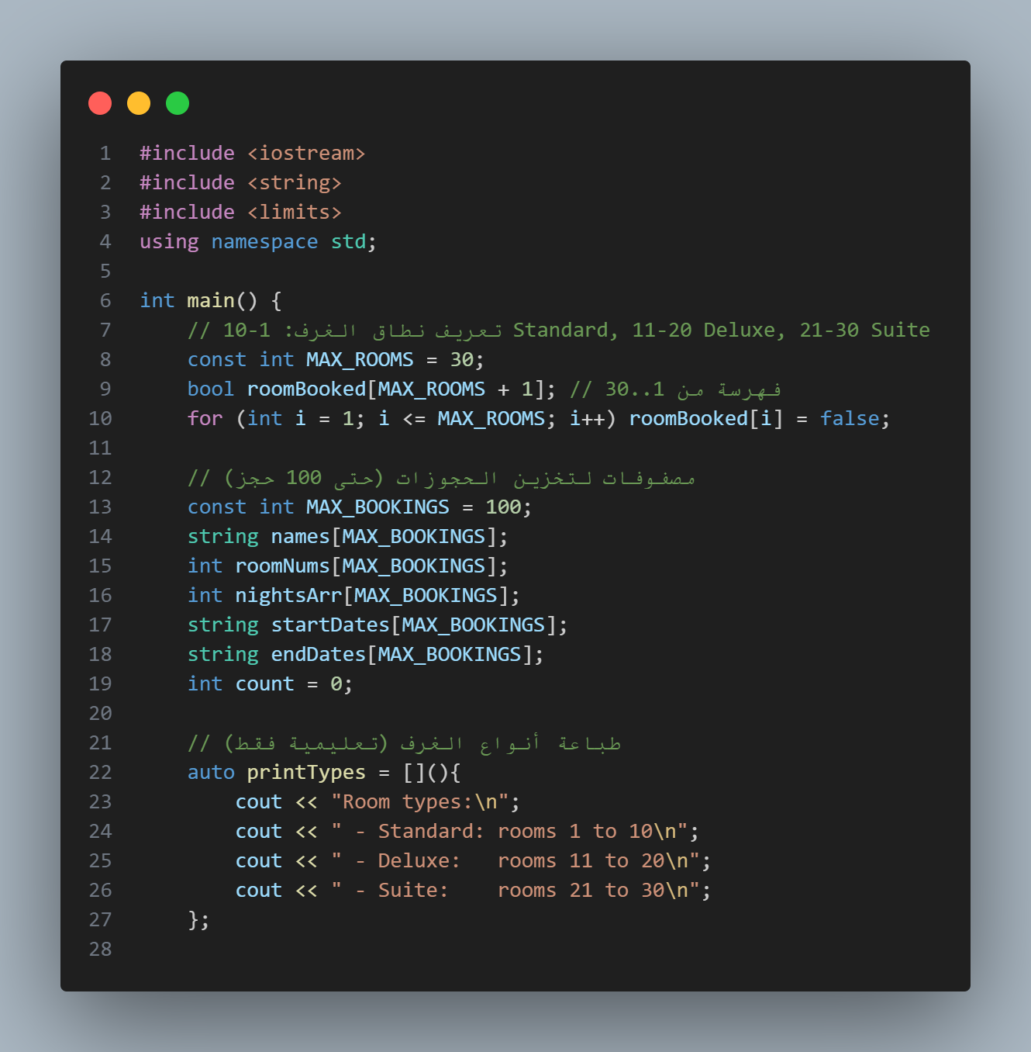
Code Explanation Block1(1-28):
This program initializes a basic hotel management system. First, it sets up 30 rooms and marks them all as 'available’ (unbooked).
Then, it creates parallel arrays to store data for up to 100 bookings. The system is designed to store the following information for each guest:
Guest Name (string)
Room Number (int)
Number of Nights (int)
Start and End Dates (string)
Finally, it defines a helper function to print the available room categories: Standard (1-10), Deluxe (11-20), and Suite (21-30).

Slide 5
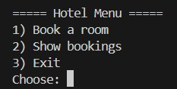
Console Output Explanation:
This screen output displays the Room Menu generated by the (print Types) function. It clearly lists the three available categories: Standard, Deluxe, and Suite.
Beside each category, it specifies the valid range of room numbers (e.g., 1 to 10 for Standard). This guide helps the user know exactly which room ID to enter when the system asks for a booking.

Slide 6
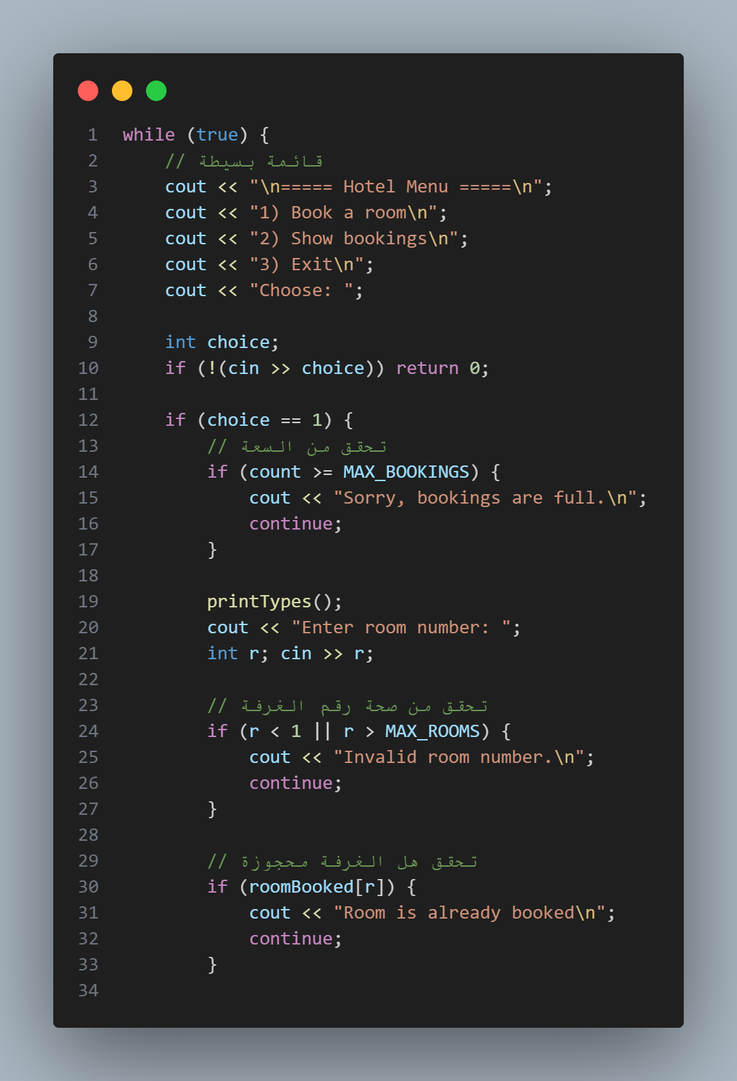
Code Explanation Block2(29-61):
The program runs inside an infinite loop (while(true)) to repeatedly display the menu.
The user can book a room, show bookings, or exit the system.
When 'Book a Room' is selected:
Checks maximum booking capacity.
Displays available room types.
Validates room number range (1–30).
Prevents double booking of rooms.
Invalid input safely returns the user to the main menu.

Slide 7
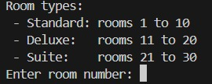
Console Output Explanation:
Program runs inside an infinite loop (while true).
Displays the main hotel menu continuously.
If option (1) Book a Room is selected : Checks maximum booking capacity & Displays available room types.
Requests a room number from the user.
Ensures the selected room is not already booked.
On any invalid input, the program returns to the menu.

Slide 8
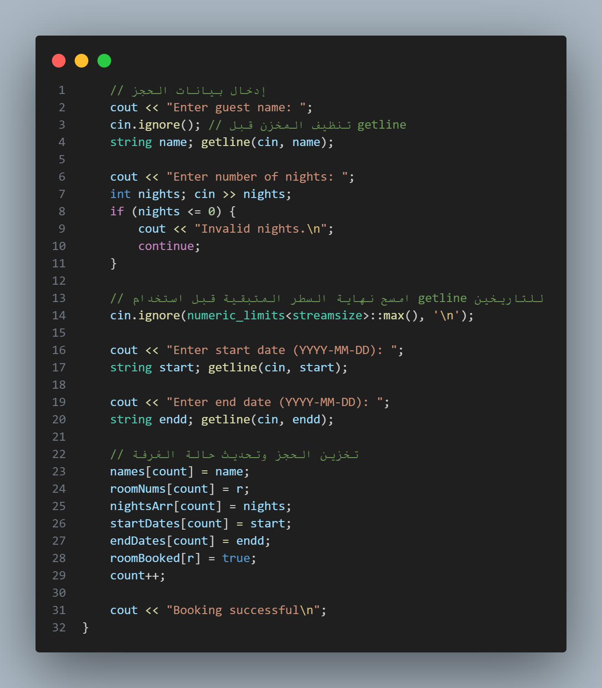
Code Explanation Block3(63-94):
Use an array to track room bookings (1-30).
Define arrays to store booking information for up to 10 bookings (names, room numbers, nights, dates).
Shows the available categories of rooms the user can choose from.
Indicates the valid range of room numbers for each category: Standard (1-10) ,Deluxe (11-20) , Suite (21-30).

Slide 9
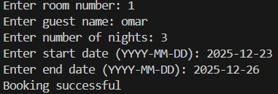
Console Output Explanation:
Initiating Booking: The user enters "1" to start a booking, prompting the system to display room categories and availability.
Data Entry: The system records the room number, guest name, and sets the stay duration to 3 nights with specific dates.
Storage Confirmation: Upon successful validation, the system confirms the entry with a "Booking successful" message.

Slide 10
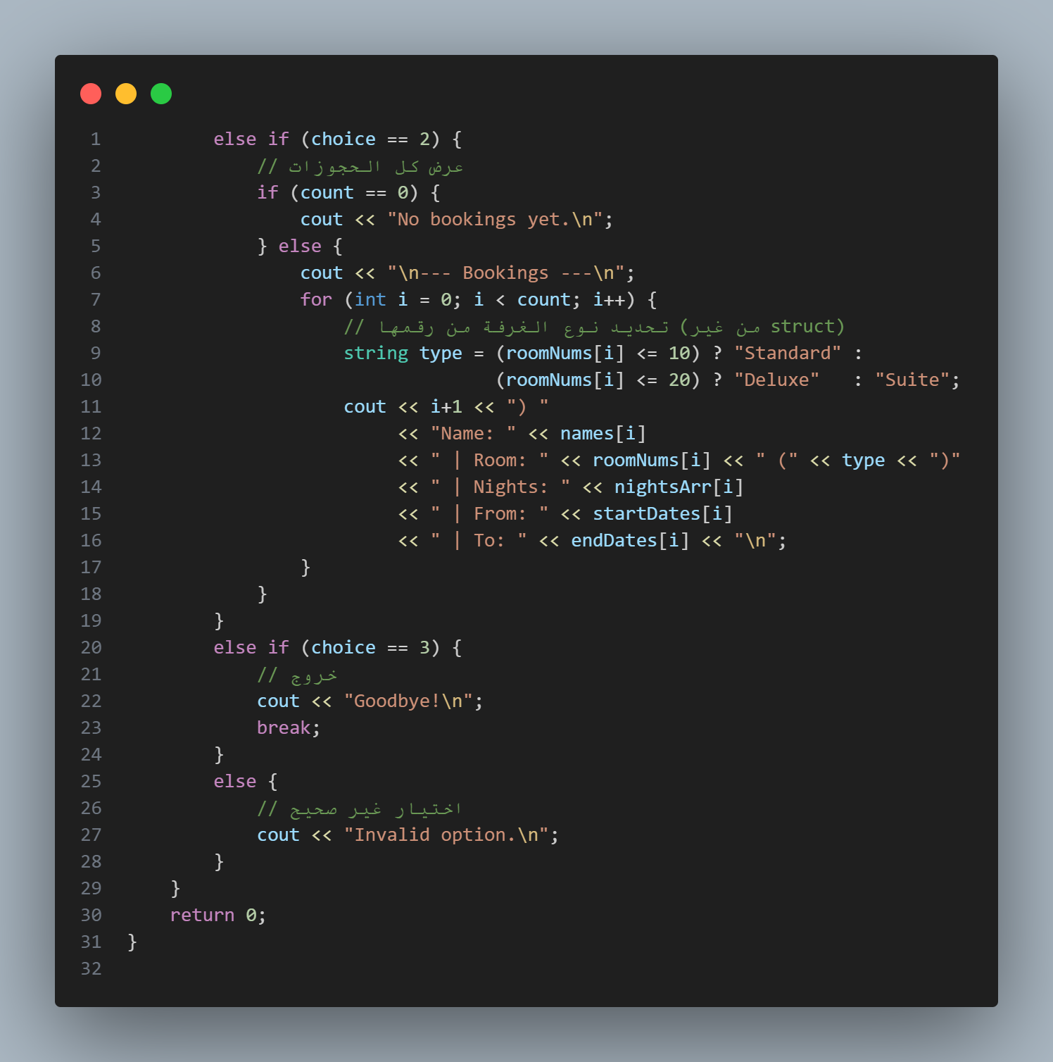
Code Explanation Block4(94-126):
When the user selects option 2, the program begins executing the following steps:
It uses an if (count == 0) to check if there are any bookings.
A for loop: If bookings are found, the program iterates through the arrays from the first element to the number stored in the count.
The program prints a line for each booking containing: the customer's name, room number and type, number of nights, and the start and end dates.
If the user selects option 3: The program prints a farewell message, "Goodbye!".
If the user enters any number other than (1, 2, or 3): The program prints "Invalid option" to indicate that the selection is incorrect.

Slide 11
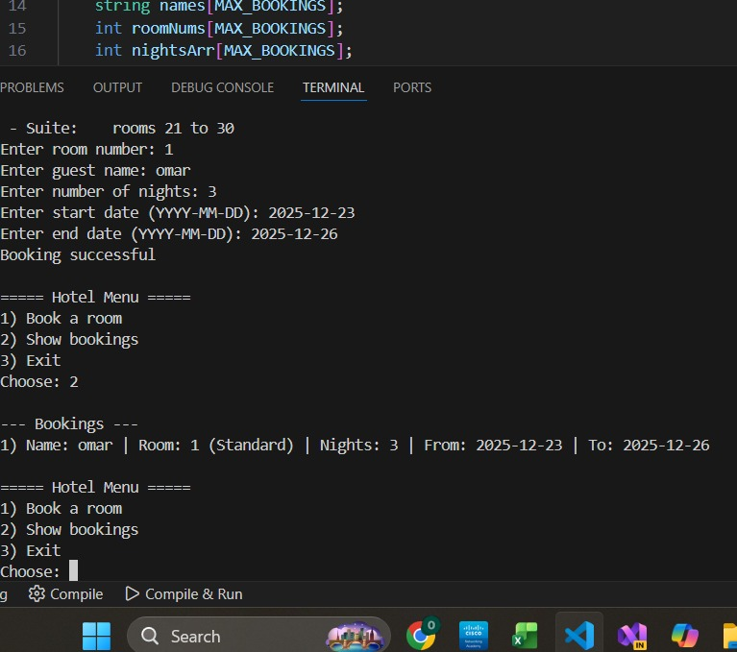
Console Output Explanation:
When choosing number 2, there was a reservation under the name Omar, room number 1, and he selected the room type as Standard based on the number and the number of nights, 3, from 23-12-2025 to 26-12-2025

Slide 12






Summary
Libraries
Uses <iostream> for standard input/output, <string> for text processing, and <limits> for managing the input buffer.
Core Functionality
Implements room categorization (Standard/Deluxe/Suite) and availability tracking using indexed arrays to manage hotel inventory.
Variable Types
Employs int, string, and bool types within parallel arrays and constants to store guest records and room status.
Input Validation
Integrates cin.ignore() with numeric_limits to maintain data integrity and prevent errors when switching between numeric and text inputs.
Control Statements
Utilizes an infinite while loop for the main menu and nested if-else branching for feature selection and validation.
Modular Logic
Features a Lambda expression for reusable UI tasks and uses constant variables to define strict system boundaries and memory limits.

Slide 13
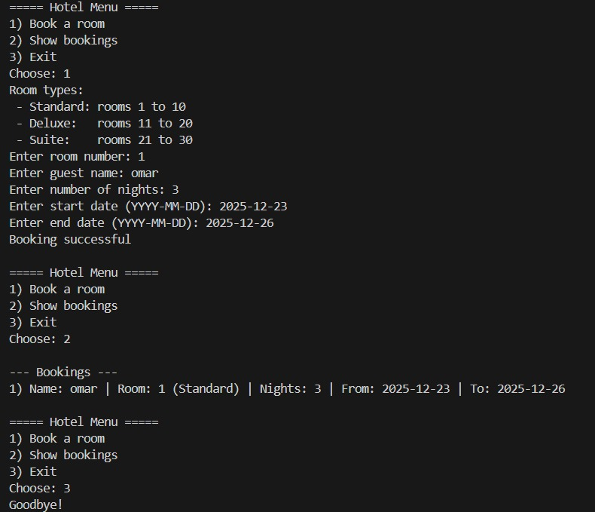

Conclusion
Final Thought: This project was a great journey in turning logic into a practical tool that serves real-world needs.
The Goal: Our aim was to create a simple, reliable experience for both the user and the business.
Special Thanks: I would like to express my sincere gratitude to Dr. Osama Ghoneim and for Eng. Omar Khaled their continuous support and guidance throughout this course.

Slide 14


Thank you
For your time

